Slide 1
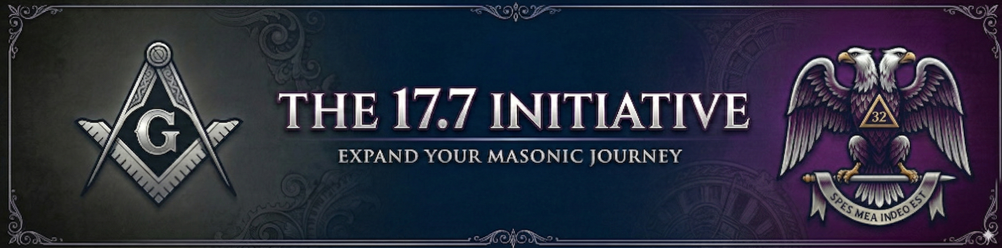

Slide 2


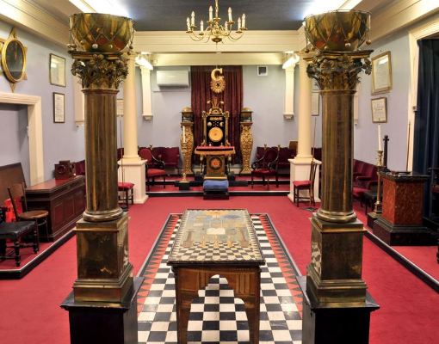
What is the “17.7 Initiative”?
A membership recruitment strategy that utilizes Article 17 section 7 of the Statutes of The Supreme Council of the Thirty-third Degree to formally nominate Master Masons in good standing to receive the Scottish Rite degrees and join the sponsoring Valley.

Slide 3

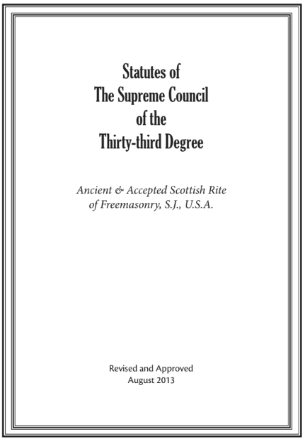
Article 17, Section 7
Statutes of The Supreme Council of the Thirty-third Degree, Article 17 Section 7, page 95
“Any qualified person residing within the territorial jurisdiction of this Supreme Council may be proposed at any Stated Meeting of a Body under its jurisdiction by proposition in writing, signed by one member and seconded by another, also in writing. Such proposition may be made without the knowledge of the person proposed. A Body may, by its bylaws, require candidates to apply for Degrees by petition in writing.”

Slide 4
recruitment strategies

Slide 5

who to recruit
Blue Lodge Worshipful Masters
Local Shrine Leadership
District Deputy Grand Masters
Local Royal Arch High Priests
your members know best!
just open the floor for nominations!

Slide 6
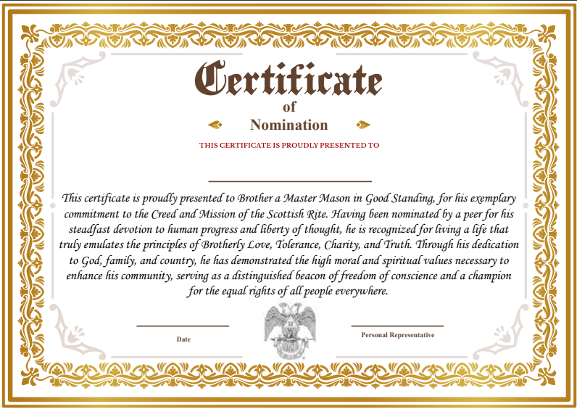
How to recognize your nominees
Create a “certificate of nomination” to be formally presented.
Create a short speech to present for the presentation of the certificate that highlights the brother’s service that has made him deserving of the nomination as well as the purpose of the Scottish Rite and make a clear connection between the two.
MAKE THEM FEEL LIKE THEY EARNED THIS BECAUSE THEY DID!

